Slide 1
Work Ethic Certification
Bullitt Lick Middle

Slide 2
Bullitt County Chamber of Commerce and Bullitt County Schools partner to develop a Work Ready Community:
Part of the mission in education is to prepare students for the transition from school to work and life beyond the classroom. It is essential that students be taught skills necessary to be successful in the world of work. Getting along with others, understanding boundaries, doing work to a high level of quality and in good quantity are important skills. It is critical that BCPS graduates value showing up for work and demonstrate excellent attendance.
Check out http://bullittschools.org/wp/ for students and select the college and career link or http://bcpsccr.weebly.com/

Slide 3
The Work Ethic Certification will demonstrate to employers that you are an individual that recognizes the importance of work ethic and has been trained to succeed in the work-place.
A student in Bullitt County High Schools earning the Work Ethic Certification will earn a seal on his/her diploma and be guaranteed an interview with participating businesses for jobs which they qualify.

Slide 4
Why Earn this in middle school?
Our goal is to prepare you for High School and build awareness so you can make the best educated decision for your future. This is a great program in the High School so if you know about it now you can be prepared for it when you go to High school.
Each student that earns this certification will be recognized at our end of the year Awards ceremony.
The qualifications are similar to our current Gold card rewards, this will earn you recognition for a school district initiative.

Slide 5
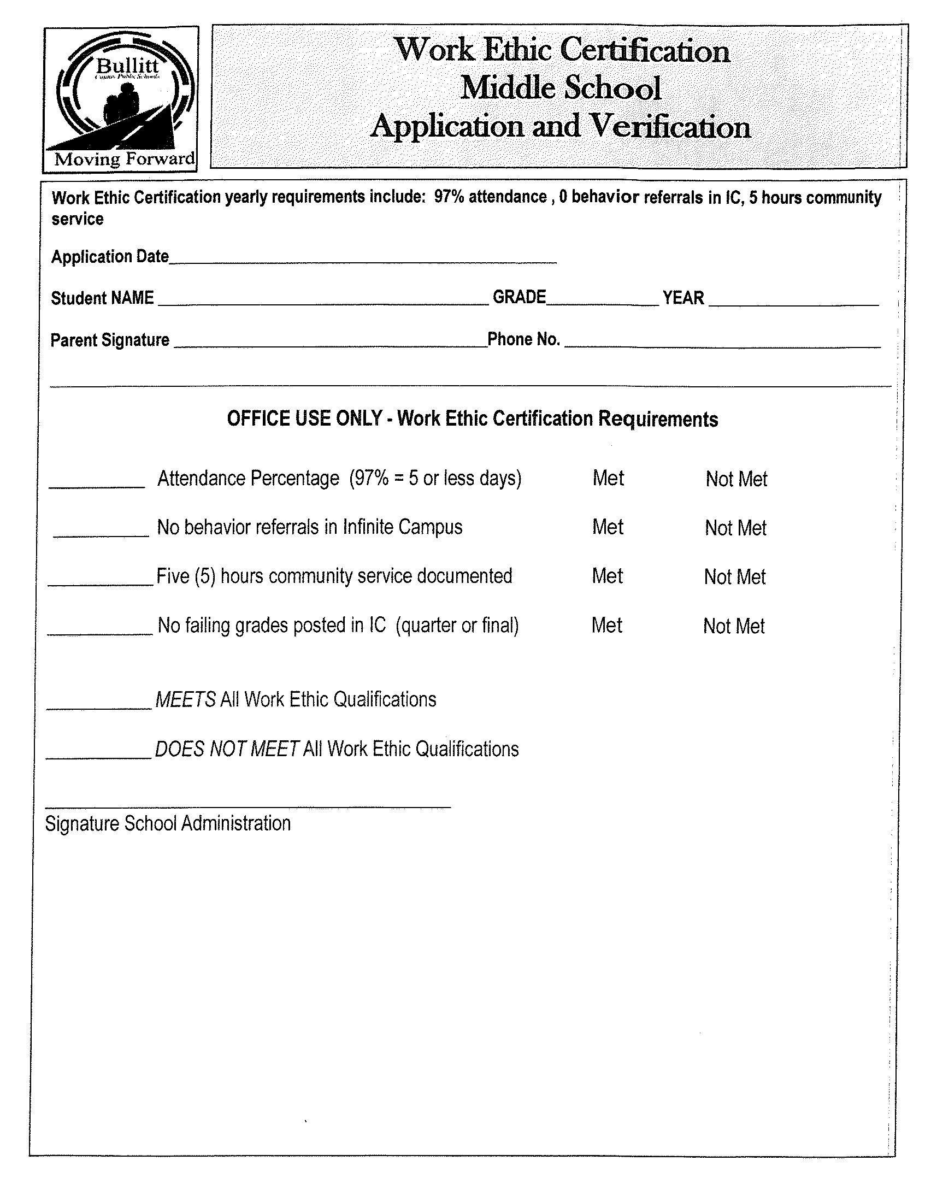
Form

Slide 6
Community service form

Slide 7
What next? :
Complete the top portion of the application and return to your 1st period teacher.

